Slide 1

COVID-19 ANALYSIS
Tabular Data Visualization
CSIT 359/553: Project-1
Presented By: Jyoti Yadav, Sneha Kondapalli, Mounica Kandula

Slide 2
Objectives
Study the trend of COVID-19 growth Globally and in different states of US.
Analyze any link between different COVID-19 dataset attributes.
Explore relationship between Active, Death and recovered cases Globally.

Slide 3
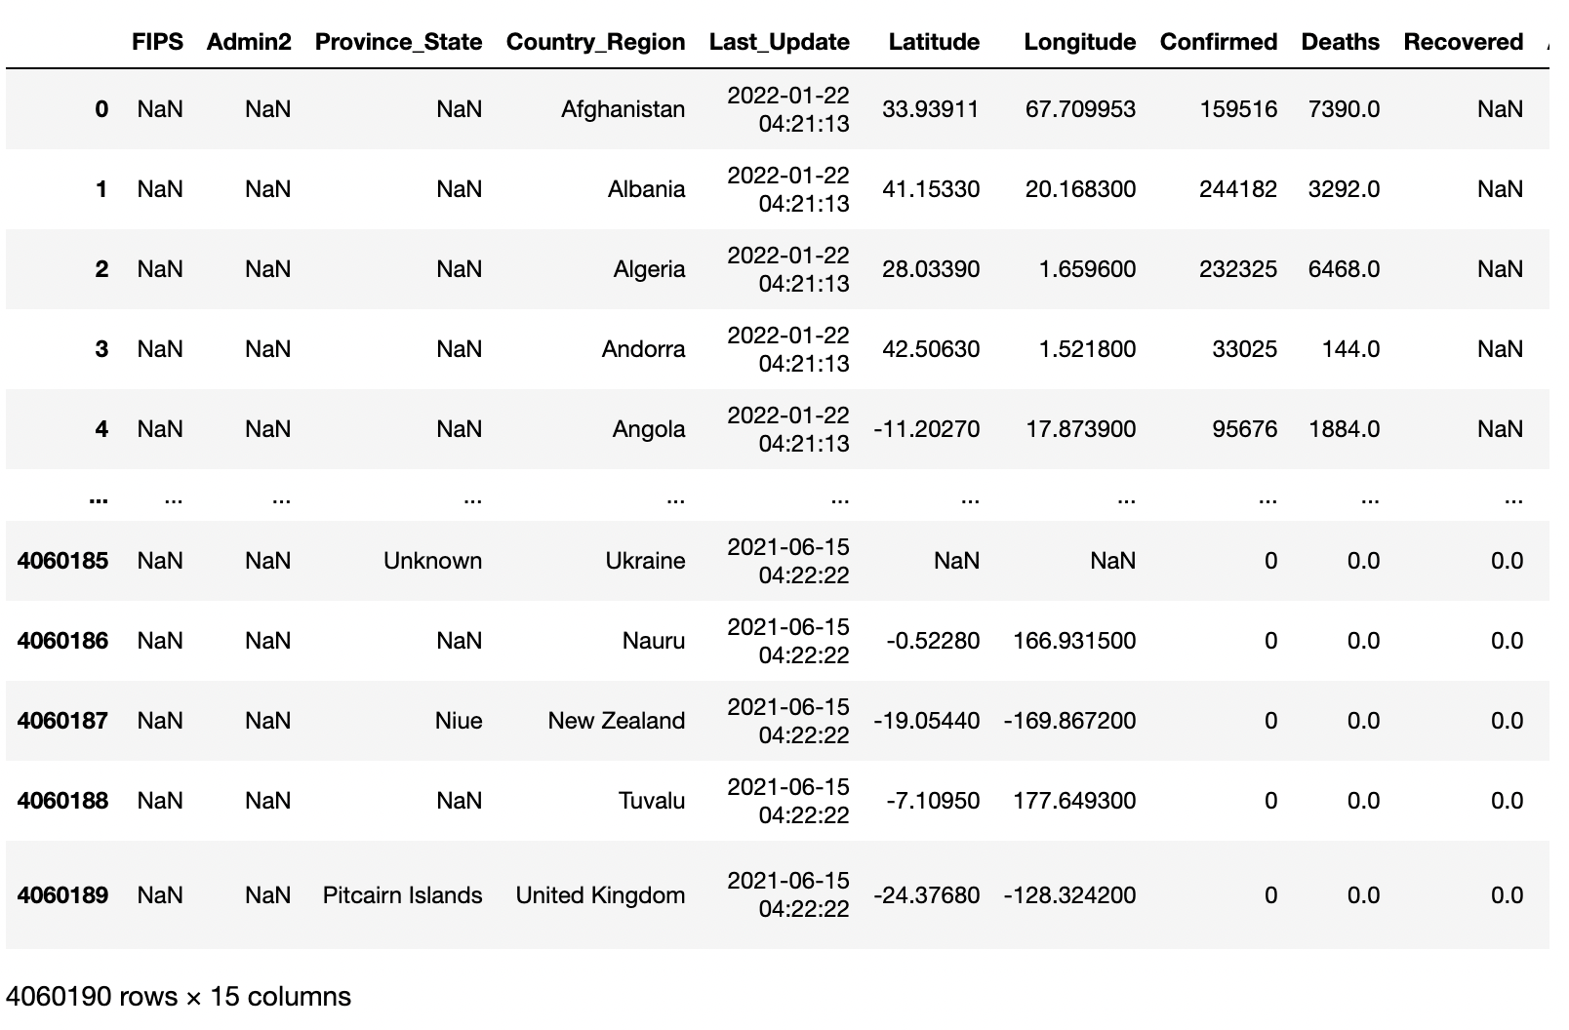
Dataset Used
Covid-19 Daily reports Globally.
Covid-19 daily reports US.
Covid-19 Time_series Data
a.Time_series_covid19_confirmed_US
b.Time_series_covid19_confirmed_global
c.Time_series_covid19_recovered_global

Slide 4
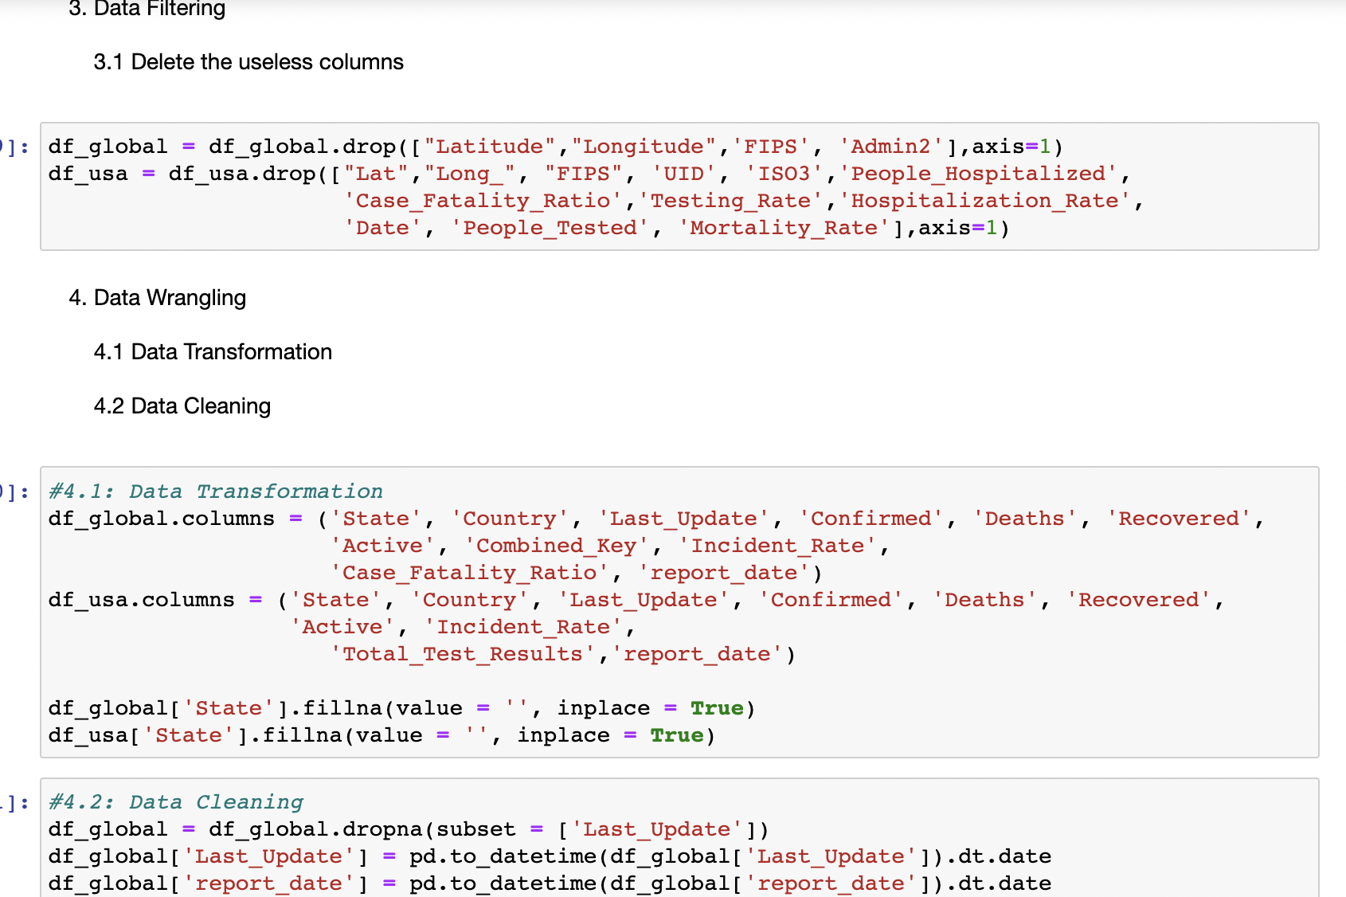
Exploratory Data Analysis
Exploratory Data Analysis steps:-
Data Loading
Data Filtering
Delete unused columns
Data Wrangling
Data Transformation
Fillna
Rename columns
Data Cleaning
Dropna
Datetime formatting
Descriptive Analysis:
Summary statistics
Explore relationships between variables
Interquartile range (IQR) & Identify outlier
Skewness and kurtosis of a variable
Distribution of the data

Slide 5
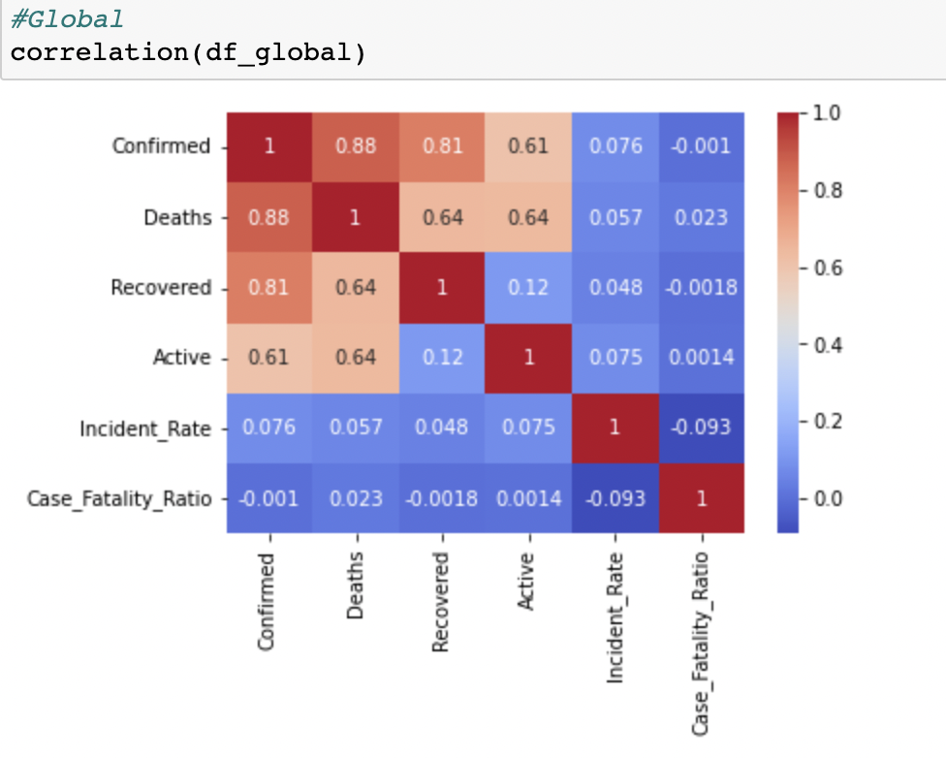
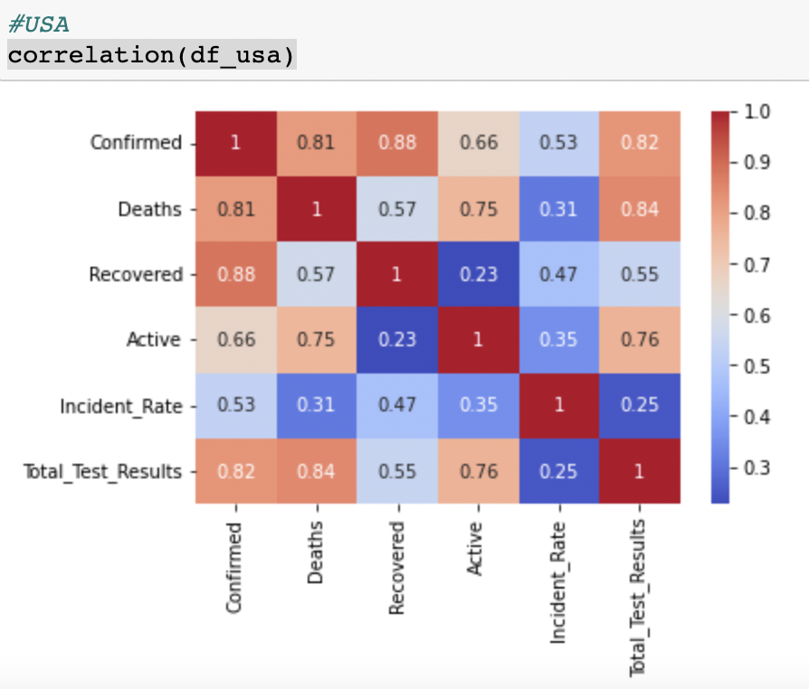
Exploratory Data Analysis cont.
Data Analysis using Descriptive Statistics.
Pearson correlation
+0.88 - Strong positive correlation between confirmed cases and deaths globally.
+0.81 - Strong positive correlation between confirmed cases and Deaths in US.

Slide 6
Data Visualization
Used Bubble plot to show top confirmed cases countries:
Used Marks in the form of point
Channels such as X and Y axes, size, and color represent multiple variables in a single plot
Used h-bar plot to show countries with the highest death cases:
Mark: line
Channel: separated countries vertically, aligned number of deaths horizontally, used horizontal axis to mark Numerical value.
Used v-bar plot to show the highest recovered cases:
Mark: line
Channel: separated countries horizontally, aligned the number of recovered cases vertically, Used horizontal axis to mark Numerical value
The color or shading of the bars represents the number of recovered case variables Used line plot
Used Area plot to show cumulative cases, death and recovered:
Mark used in area plot isline
Used spatial Channel to represent the data along the continuous axis

Slide 7
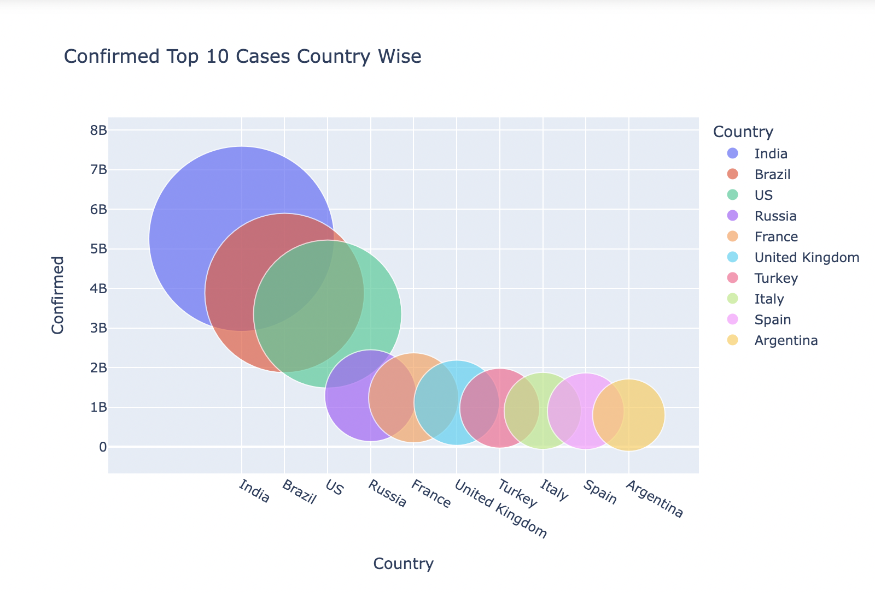
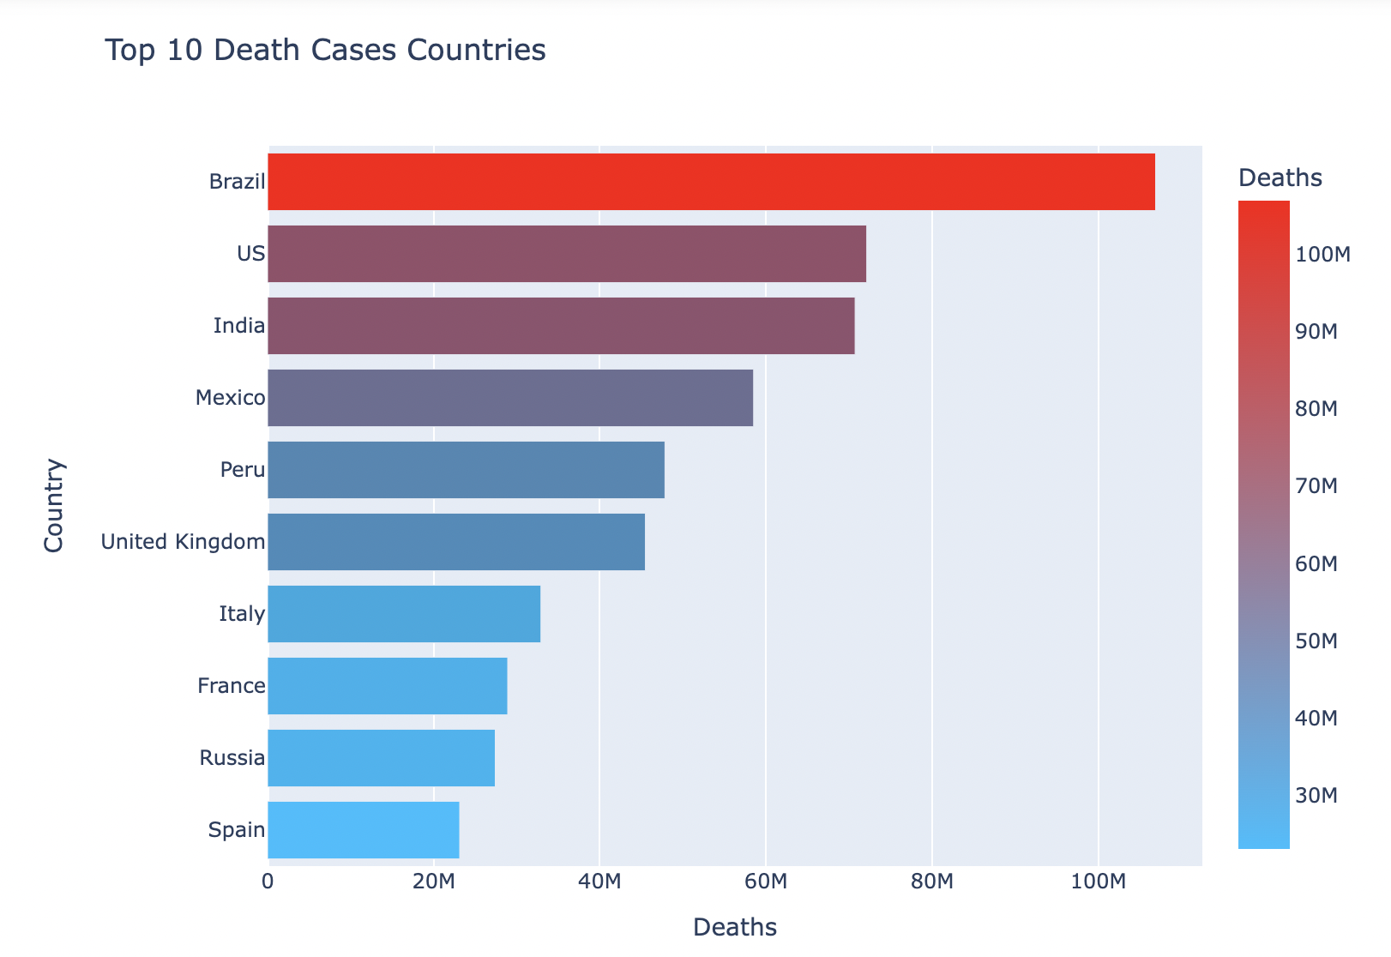
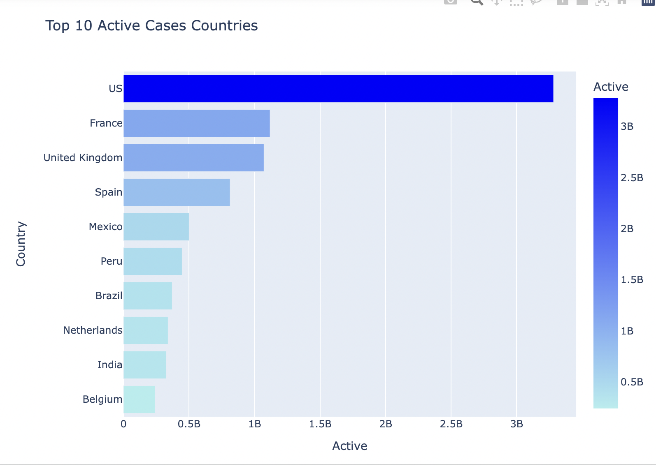
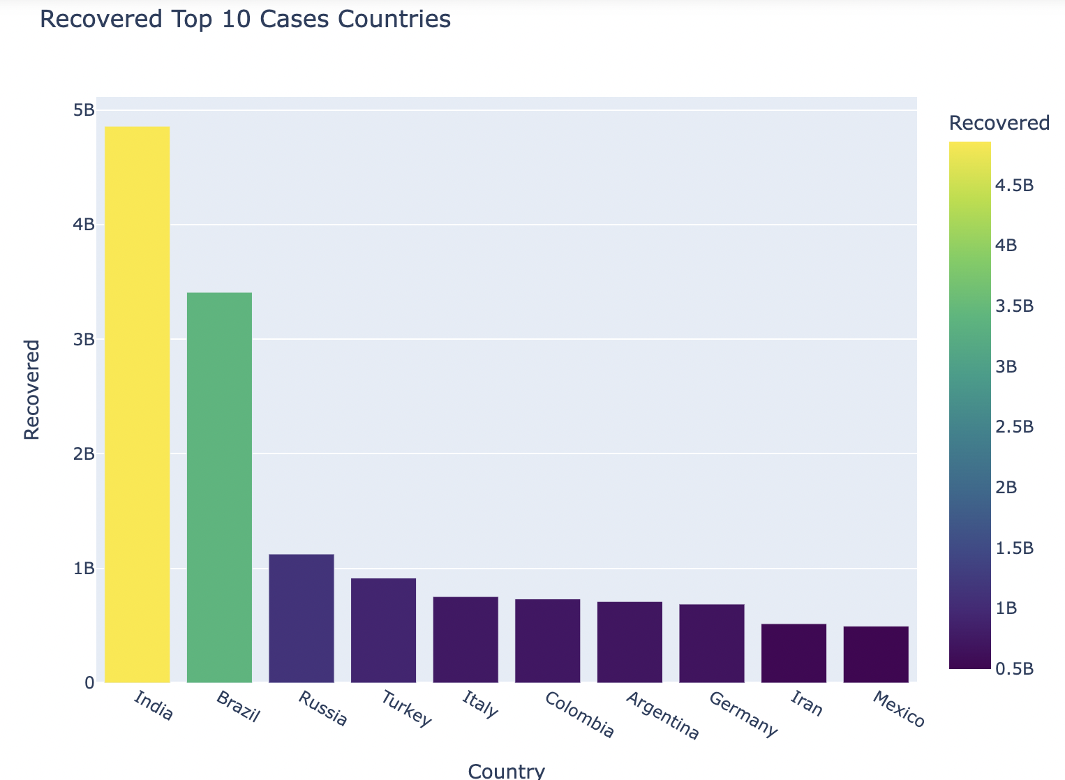
Data Visualization
Analysis 1: Ranking countries and states
a) Top 10 Confirmed Cases Countries
b) Top 10 Death Cases Countries
c) Top 10 Recovered Cases Countries
d) Top 10 Active Cases Countries

Slide 8
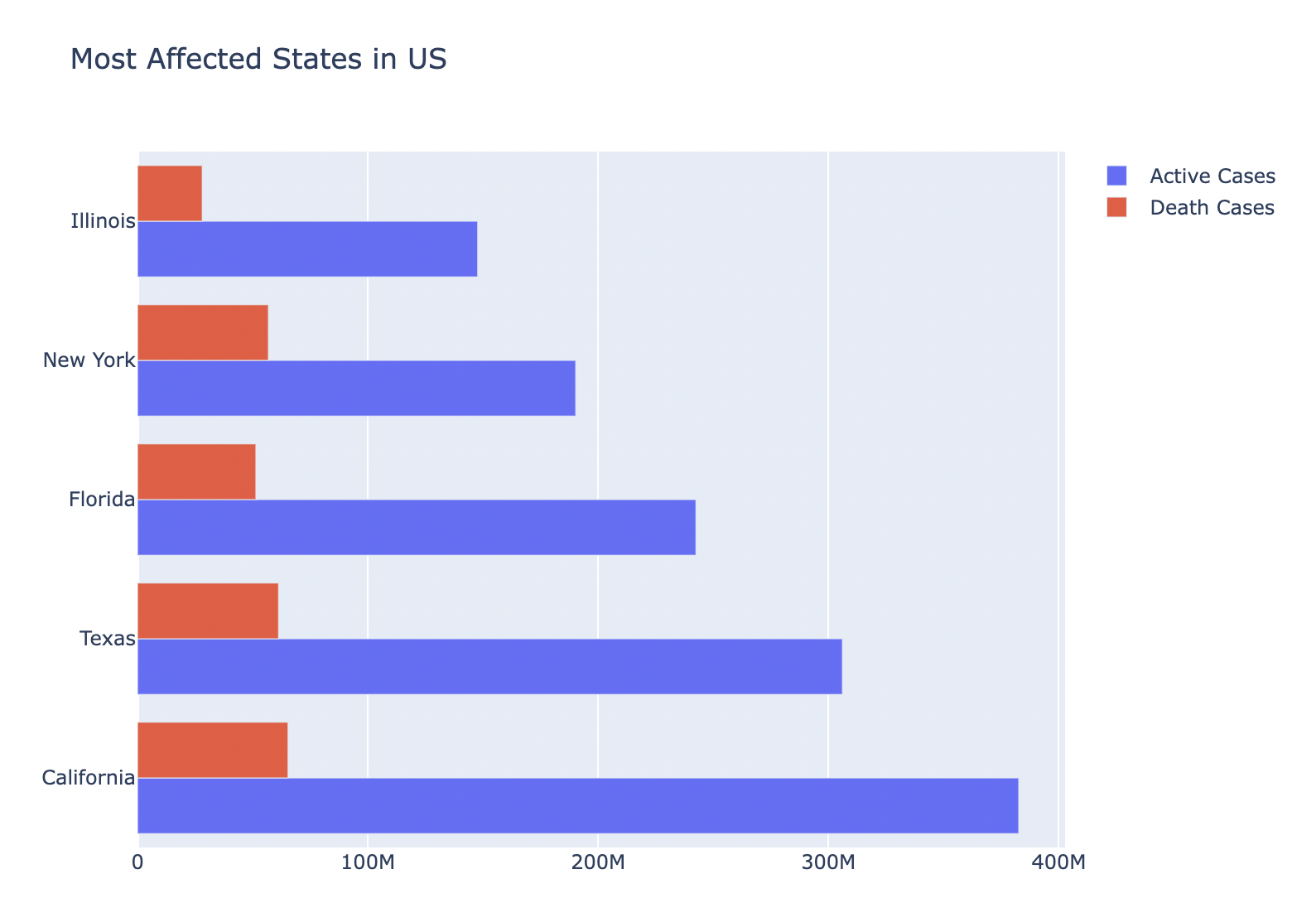
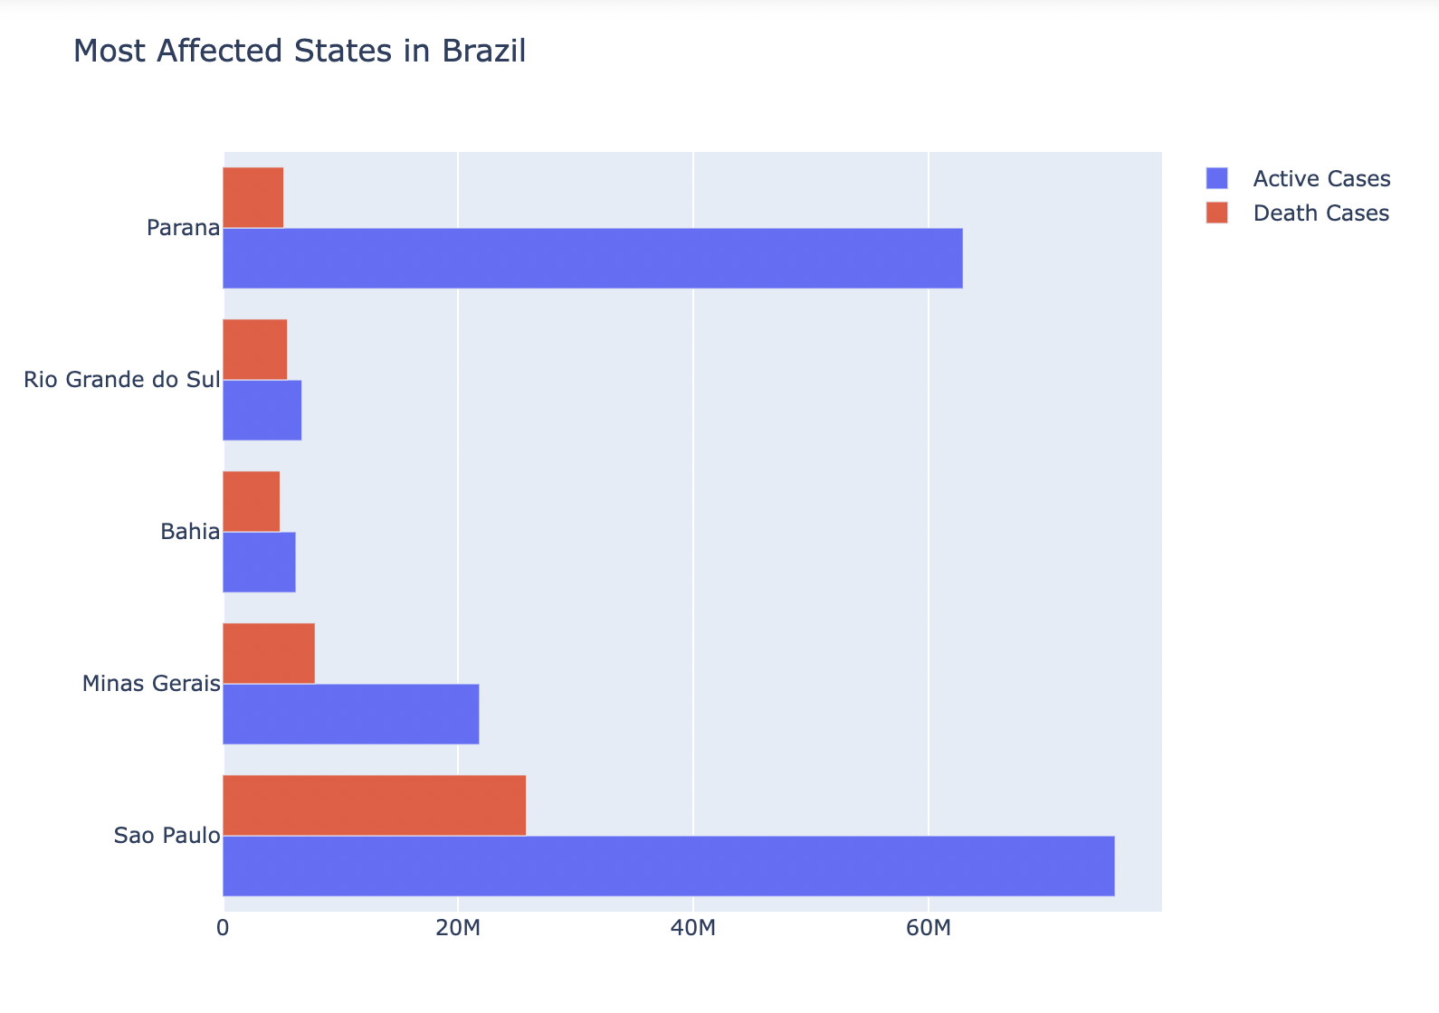
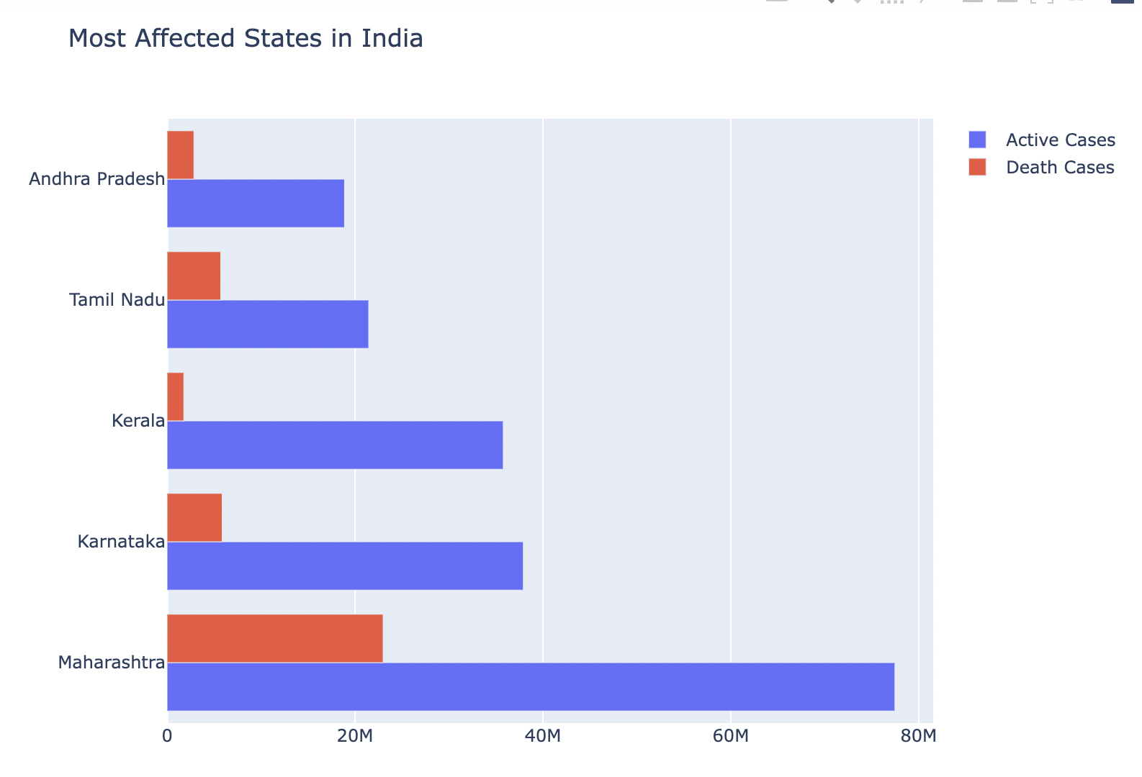
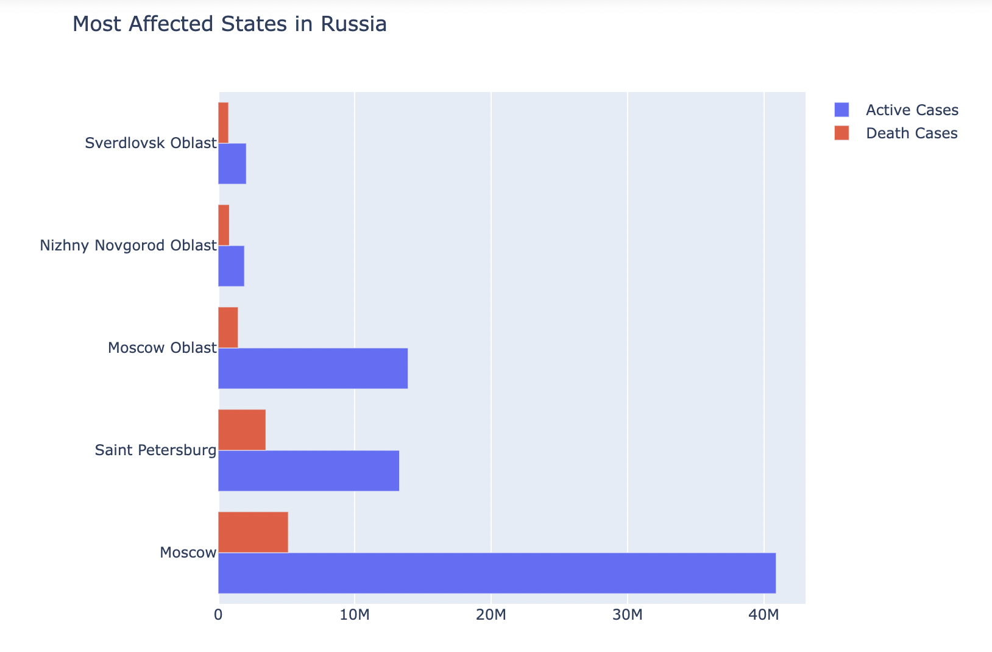
Data Visualization cont.
Analysis 2: Ranking most affected States in most affected Countries
USA
b) Brazil
c) India
d) Russia

Slide 9
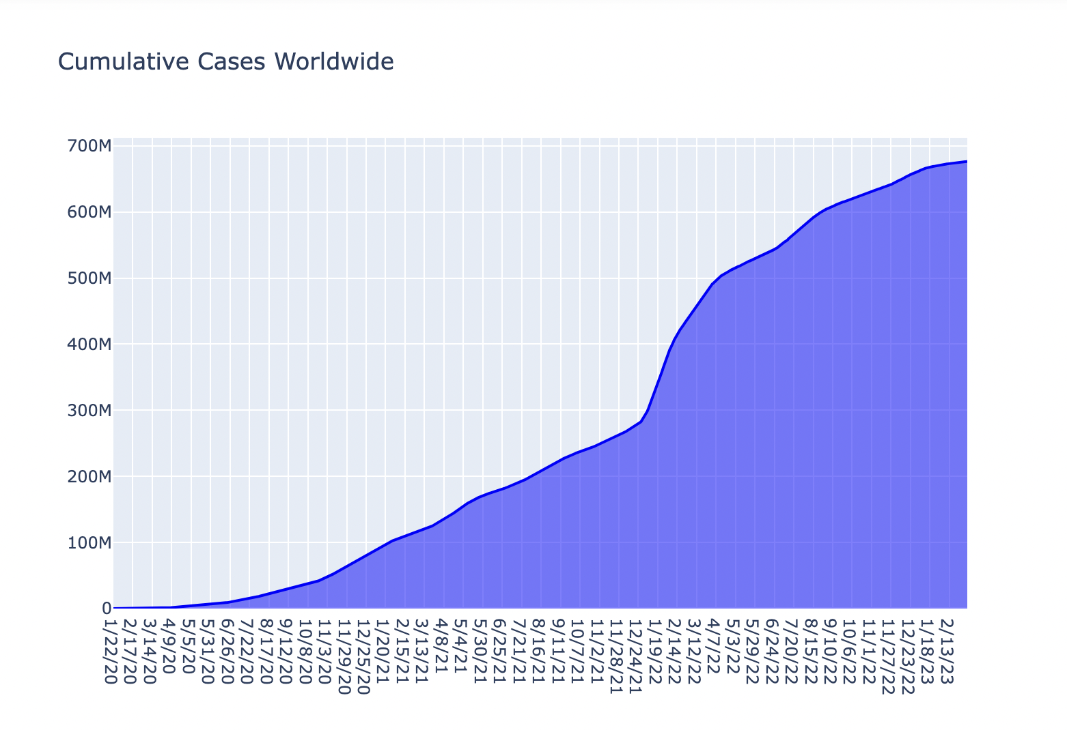
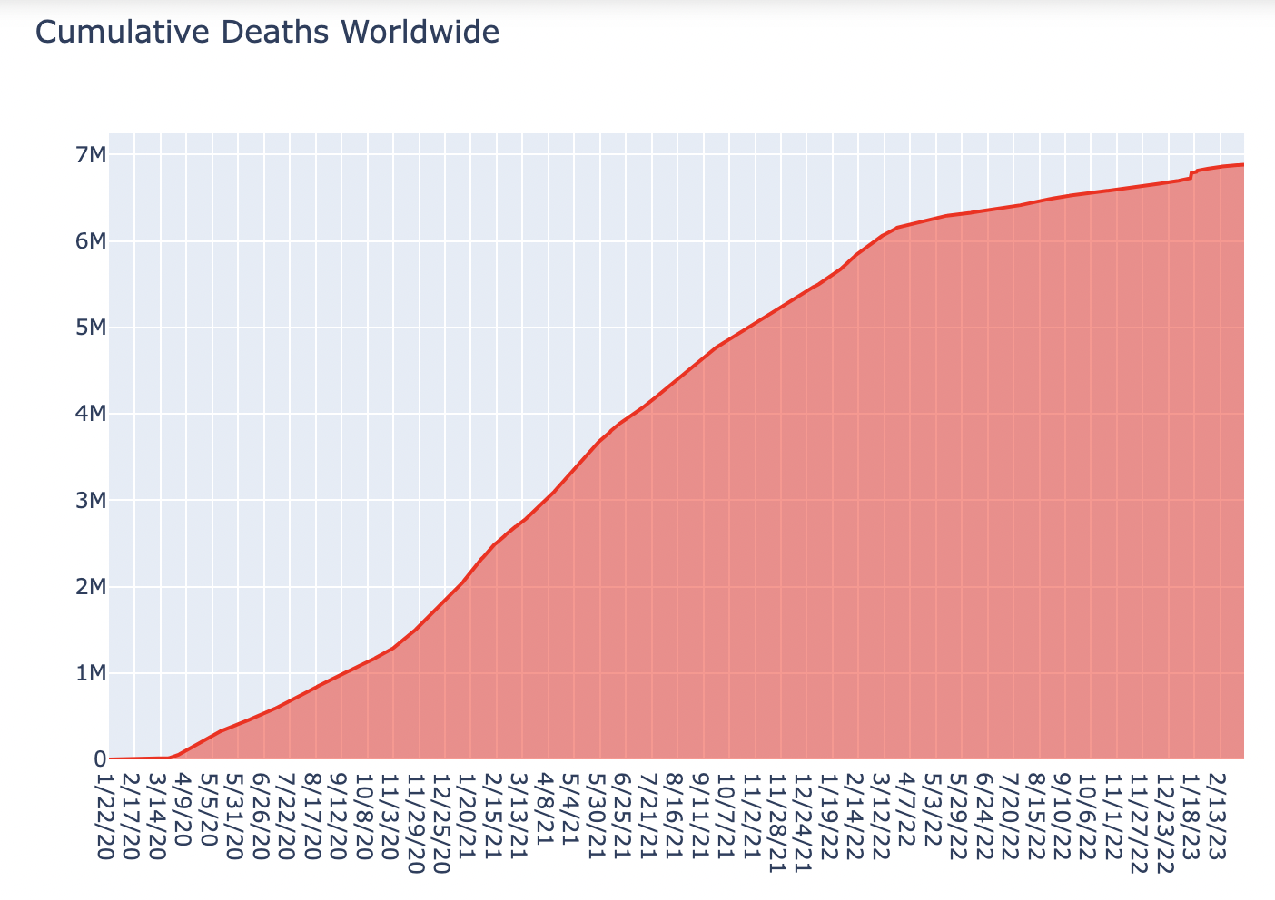
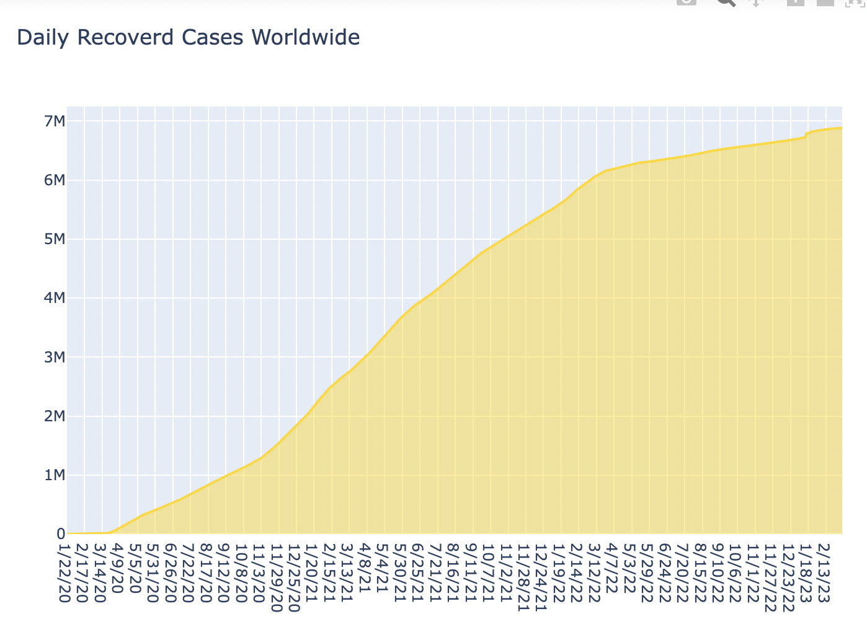
Data Visualization cont.
Analysis 3: Time Series on COVID-19 Cases:
Cumulative COVID-19 cases worldwide
b) Covid-19 cumulative deaths worldwide
c) Cumulative covid-19 recovery worldwide

Slide 10
Conclusion
Most affected country with the Covid-19 is USA.
Country with highest death rate is Brazil across the globe.
The countries with the best recovery rate is India, Brazil and Russia
There is a proportional increase in the number of deaths and recoveries(experiencing a similar upward trend).

Slide 11
References
https://www.kaggle.com/code/hamelg/python-for-data-21-descriptive-statistics
https://www.kaggle.com/code/yashvi/practical-statistics-1-descriptive-statistics
https://dipankarmedh1.medium.com/descriptive-statistics-in-python-2f6f725739b1
https://www.researchgate.net/publication/353332767_DATA_ANALYSIS_ON_COVID-19

